Slide 1


By Glenville Pecor & Christopher Torrecampo

Slide 2
Description
Summary: Code-breaking logic game/puzzle
Logic:
Red Light: Incorrect character
Yellow Light: Correct character but wrong location
Green Light: Correct character and correct location
Features:
3 Difficulties
Stat-tracking
Endless gameplay (until you lose)

Slide 3
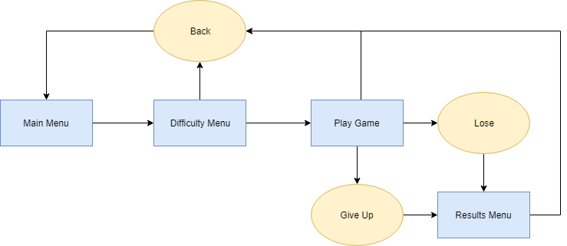
Flowchart

Slide 4
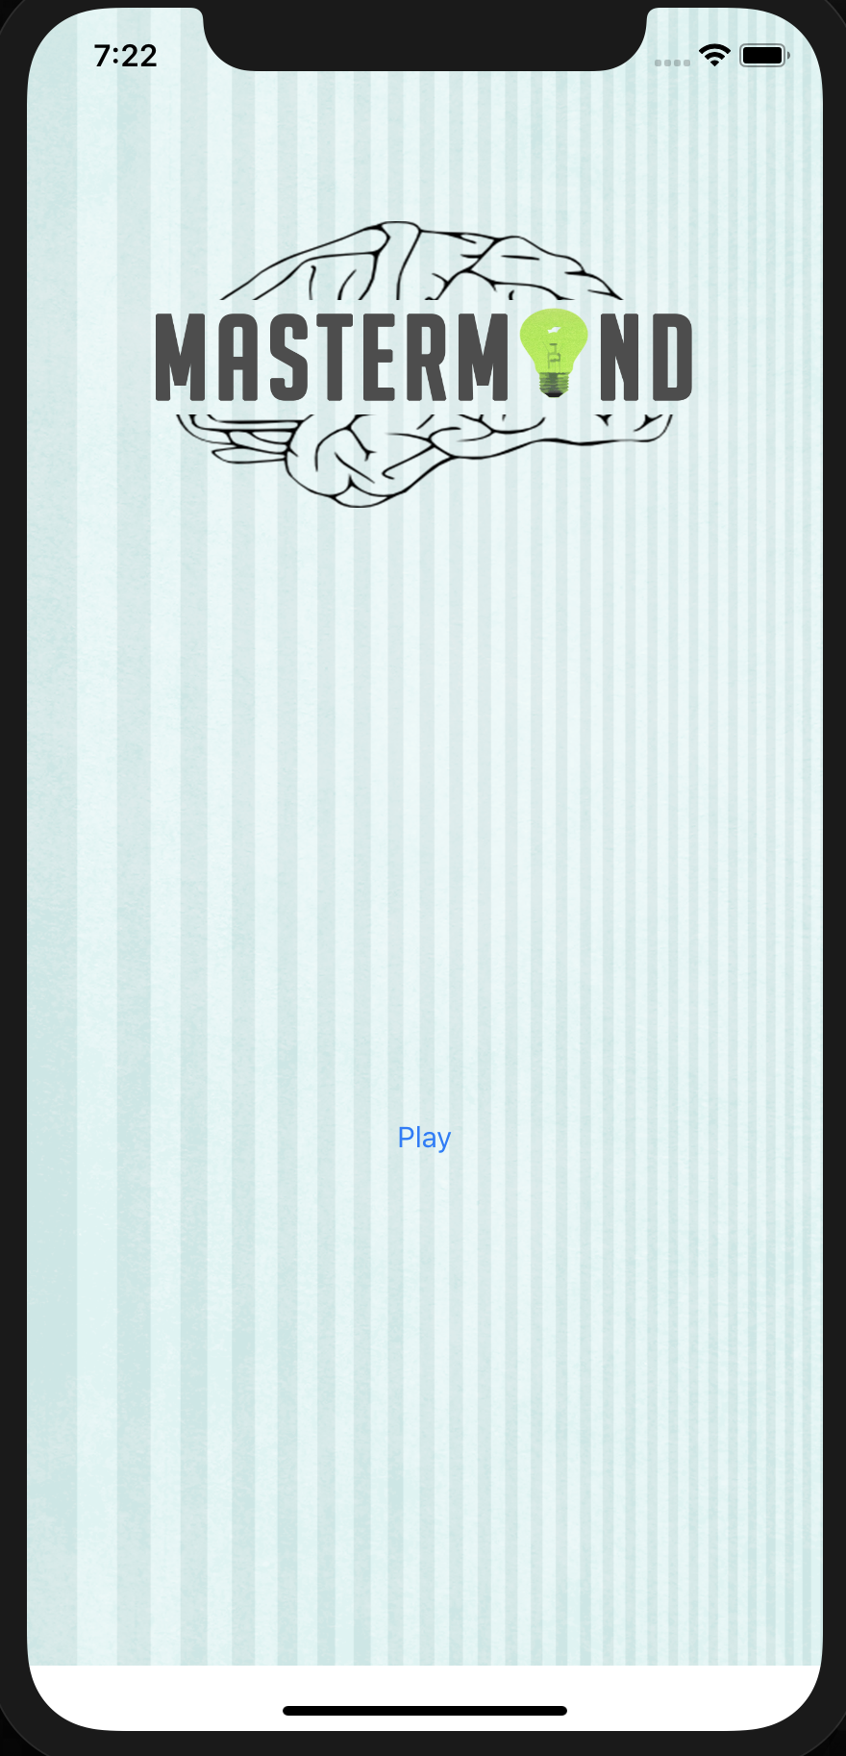
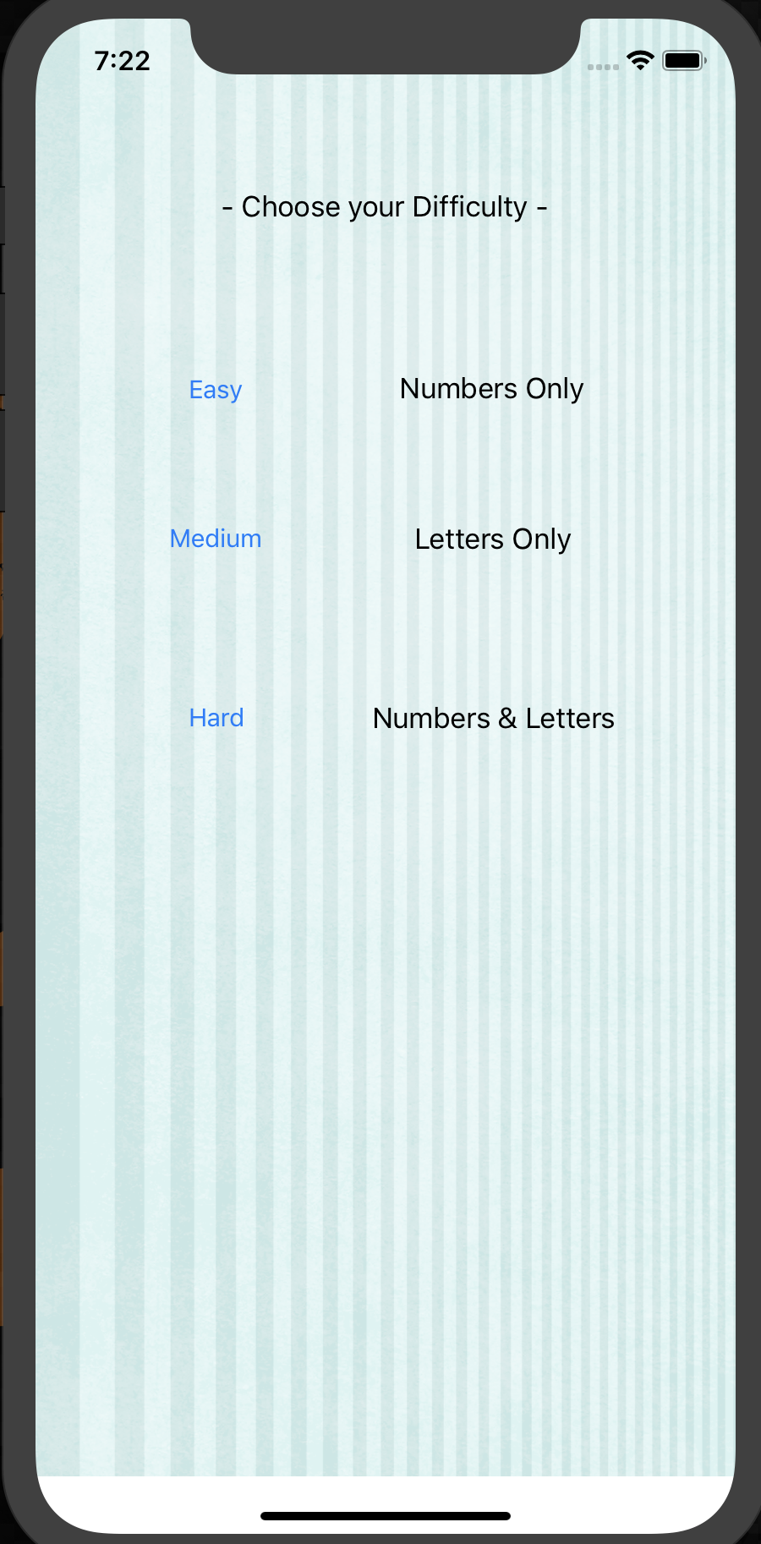
App Screenshots
Main Menu
Difficulty Menu

Slide 5
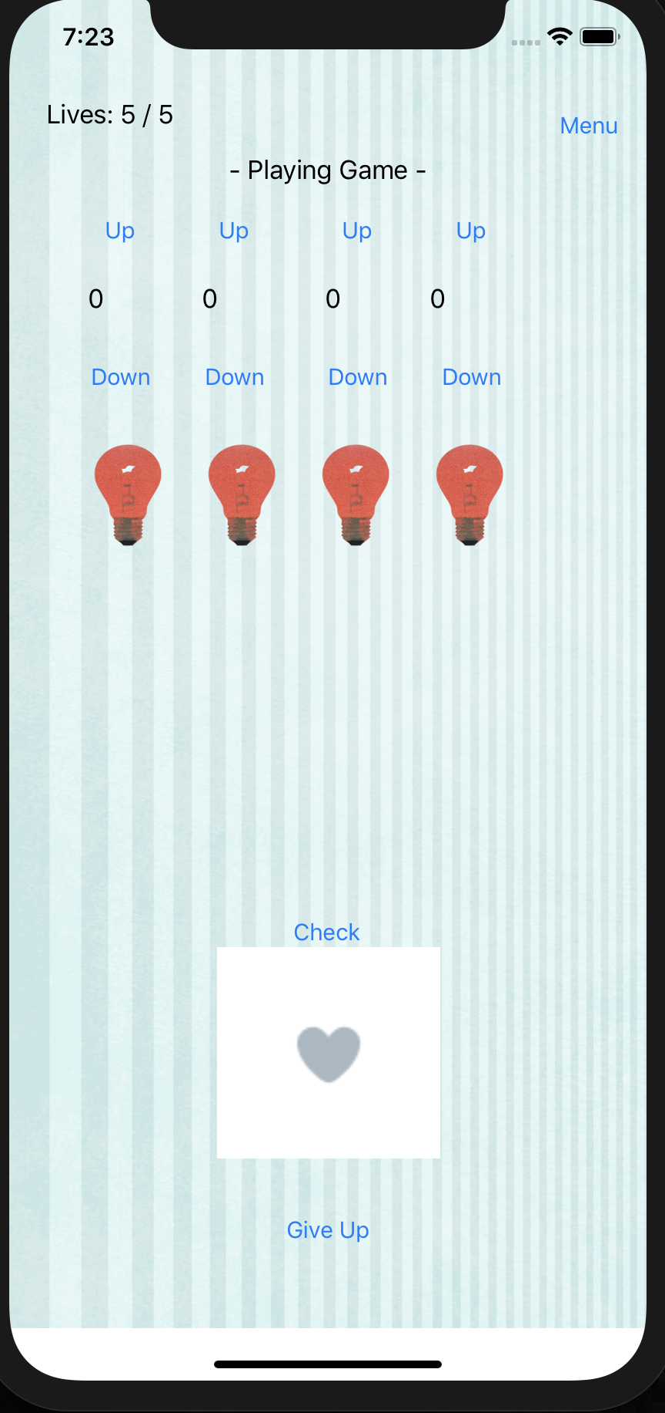
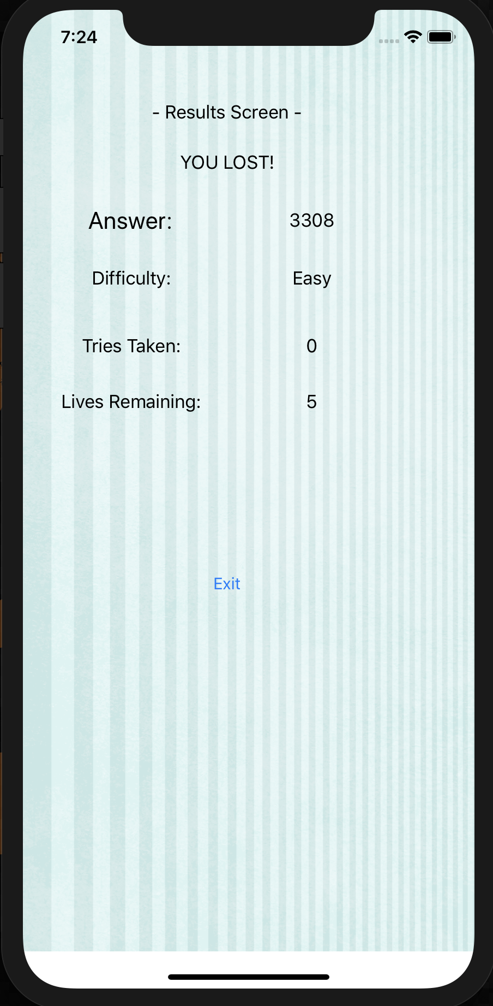
App Screenshots
Play Screen
Results Menu

